Slide 1
SYNTAX ANALYSER FOR CONDITIONAL (IF-ELSE STATEMENT)
18CSC304J – Compiler Design

Slide 2
Team members
VASU BUCHINGARI(RA2011003010412)
CHANDRA SEKHAR KARNA(RA2011003010435)

Slide 3
Introduction
A syntax analyzer for conditional (if-else statement) is a program that checks whether a given input string follows the syntax rules for a valid if-else statement. It takes as input a string representing an if-else statement and checks whether the syntax is correct according to a set of predefined grammar rules.The analyzer uses a recursive descent parsing technique,where each non-terminal symbol in the grammar is represented by a separate function.
The program checks for syntax errors such as missing or extra tokens, incorrect use of operators and keywords, and invalid expressions or statements.

Slide 4
PROBLEM STATEMENT
The syntax analyzer should also be able to detect and report any syntax errors in the if-else statement, such as missing or mismatched parentheses or braces. Additionally, the syntax analyzer should be able to generate an abstract syntax tree (AST) that represents the structure of the if-else statement and can be used as input for subsequent stages of the compiler, such as the code generator.

Slide 5
METHODOLOGY
Define the grammar: The first step is to define the grammar for the programming language that the syntax analyzer will analyze. This involves specifying the syntax and structure of if-else statements, as well as any other conditional statements that will be supported.
Implement the lexer: The lexer (also known as the scanner) is responsible for breaking up the source code into tokens, which are the basic building blocks of the syntax analyzer. The lexer reads the source code character by character and converts it into a sequence of tokens that can be processed by the parser.
Implement the parser: The parser is responsible for analyzing the structure of the if-else statements and generating an abstract syntax tree (AST) that represents the structure of the program. The parser uses the grammar defined in step 1 to determine the structure of the program and detect any syntax errors.

Slide 6
Implement error handling: The parser should be able to detect and report syntax errors in the source code. The syntax analyzer should also include error recovery mechanisms to handle situations where the source code contains errors that prevent the parser from generating a valid AST.
Testing and integration: Finally, you should thoroughly test the syntax analyzer to ensure that it can correctly parse all valid input programs and handle errors gracefully. The syntax analyzer can then be integrated into a larger compiler system, along with other modules such as the code generator and optimizer.

Slide 7
REQUIREMENTS
Software Requirements:
An IDE (Integrated Development Environment)
A lexer generator tool (e.g., Flex, ANTLR) for generating the lexer code
A programming language for implementing the syntax analyzer (e.g., C++, Java, Python)
Hardware Requirements:
A computer with sufficient processing power and memory
A reliable internet connection for downloading and installing software tools and libraries

Slide 8
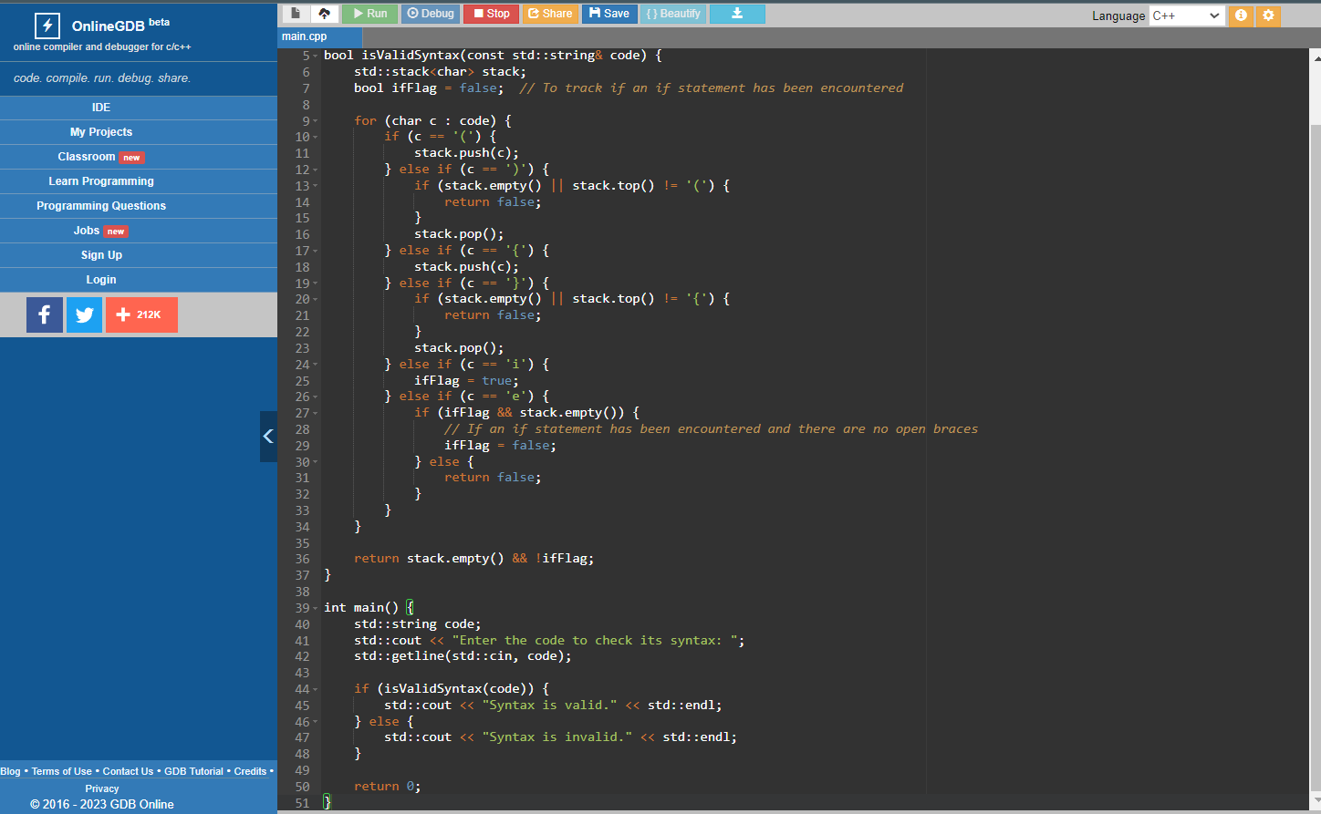
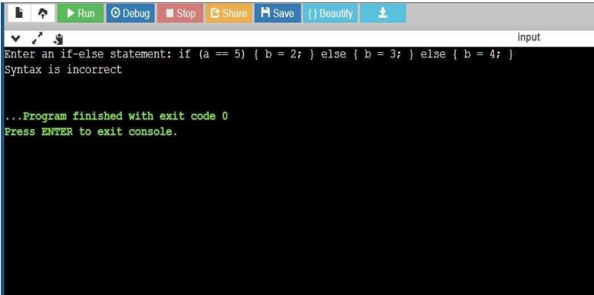
SOURCE CODE

Slide 9
RESULT
Syntax Analyser for Conditional (If-Else Statement) is successfully compiled.

Slide 10
CONCLUSION
Overall, the "syntax analyzer for conditional (if-else statement)" project is a crucial part of the compiler and plays a vital role in ensuring the correctness and reliability of the compiled program. It requires careful planning, implementation, and testing to ensure that it accurately analyzes and detects syntax errors in the conditional statements of the source code.

Slide 11

Thank you

